Slide 1
01. Polymorphism
February-13, 2019
Tomasz Lebica

Slide 2
Polymorphism
Polymorphism means “having many forms”, in programming in describes the ability to process objects depending on their types.
Polymorphism can be achieved statically (during compilation) and dynamically (during runtime).
Static can be further subdivided into ad hoc (function overload) and parametric (templates – not covered in this lecture).
Dynamic polymorphism is realized by means of subtyping (inheritance and virtual functions).

Slide 3
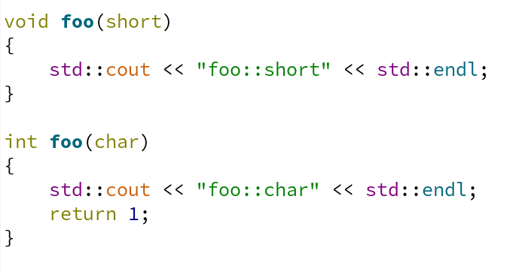
Static polymorphism – function overloading
C++ allows function overloading, i.e. declaring more than one functions with the same name in the given scope, as long as these definitions differ in:
- argument types or,
- argument number or,
- function attribute (for example const method vs non const method)
Overloaded functions can have different return values, as long as above conditions are met.
Class methods can also be overloaded *.
Version of function that will be called is determined during compilation – hence “static” polymorphism.
Rules of overload resolution are described in detail here:
https://en.cppreference.com/w/cpp/language/overload_resolution

Slide 4
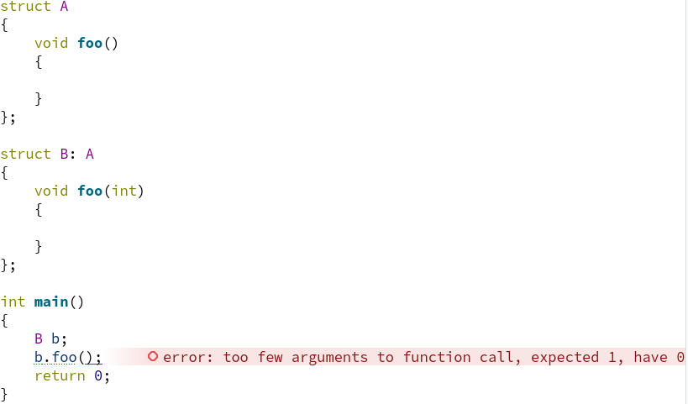
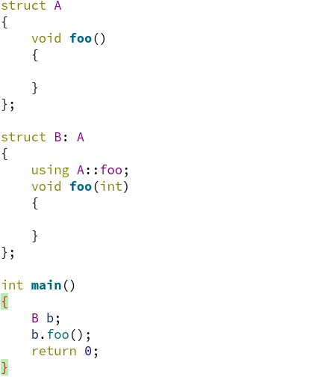
Static polymorphism – methods overloading
Class methods can also be overloaded.
Methods attributes like const and volatile affect type of first implicit argument of a method, allowing overloading based on such attributes.
Overloading methods, of the base class in derived one, will hide every version of base class method with the same name. „Using” directive can be used to make them visible in derived class scope.

Slide 5
Static polymorphism – operator overloading
C++ allows also operator overloading
Following operators can be overloaded:
+ - * / % ^ & | ~ ! = < > += -= *= /= %= ^= &= |= << >> >>= <<= == != <= >= && || ++ -- , ->* -> ( ) [ ]
User defined conversion methods can be supplied,
new/delete operators can also be overloaded
From C++11 user defined literals
More information about operator overloading can be found here:
https://en.cppreference.com/w/cpp/language/operators

Slide 6
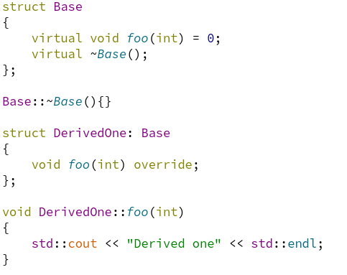
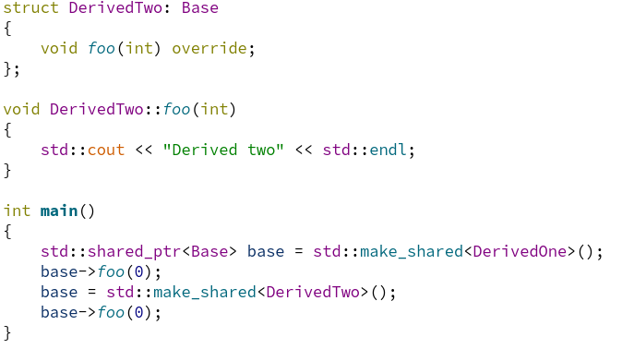

Dynamic polymorphism – basics
Dynamic polymorphism allows using instances, of different classed having common interface, in uniform way.
In C++ dynamic polymorphism is realized with virtual methods being overridden in derived classes.
Some basic information can be found here:
https://en.cppreference.com/book/intro/polymorphism
https://en.cppreference.com/book/intro/inheritance
Output:

Slide 7
Dynamic polymorphism – useful information
In order to use polymorphism, reference, raw pointer or smart pointer to base class needs to be used.
If class defines at least one method as virtual, it should also define virtual destructor to allow proper resources clean up.
Methods can be defined as pure virtual “=0”, it’s good practice to make all virtual methods (apart from destructor) pure virtual in base class.
C++11 introduces keyword “override” validating if method really overrides virtual method from base class rather than overloading it. It allows detecting programming errors during compilation time rather than runtime testing.
Dynamic polymorphism allows dependency injections, programming to interfaces, easier unit testing and design patterns.

